Slide 1
Meta-Connectomics: human brain network and connectivity meta-analyses
N. A. Crossley, P. T. Fox, E. T. Bullmore
David Yang
Introduction to Connectomics
William G. Roncal

Slide 2
Opportunity
Number of neuroimaging studies has increased in the past decade.
Correlation between organization of brain and brain disorders.
Schizophrenia - abnormalities of brain connectivity.
Inspect brain function, dysfunction at the level of interactions in a brain network.

Slide 3
Challenge
Imaging studies of human brain connectivity can be:
Technically specialized, require specific methodology
Lack of a large sample size, resulting in studies utilizing structural and resting fMRI, limiting interpretation of network properties
MRI’s macroscopic view is not sufficient enough to understand complex functions
How can we link macroscopic-scale data from neuroimaging with microscopically detailed knowledge of cells in distinct brain regions?

Slide 4
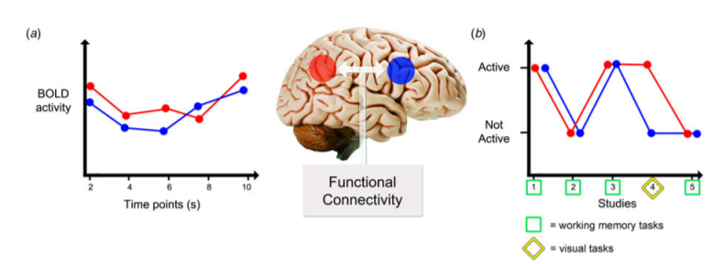
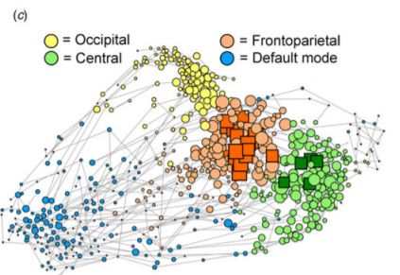
Action
Meta-connectomics: Analyzing brain networks using data from previously published primary studies, public databases
Co-activation meta-analysis: infer functional connectivity from correlated activity in primary studies - try to look for a different correlation.
Graph theory represents brain in forms of nodes and edges, edges representing co-activation.
Creating network can help make predictions that can be experimentally tested.
Role of a node can be defined in terms of the connections it has to other nodes.
Brain modules are also linked together by a group of highly connected hub regions.

Slide 5
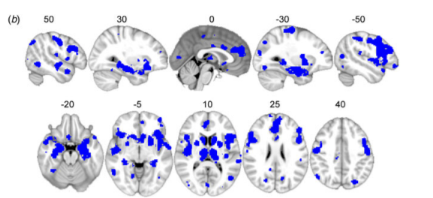
Resolution
The specific pathophysiology of a disorder determines which brain modules are affected.
Some areas of the brain are more vulnerable or symptomatic to certain disorders.
Extensive anatomical overlap between structural abnormalities in 26 brain disorders, mostly in highly connected brain regions.
Brain over-activates in some regions to compensate for other under-activations in brain disorders.

Slide 6
Feedback/Future Work
Very informative, easy to understand, some new vocabulary, explained promise of connectomics very well.
A bit broad, methodology and data of discussed experiments was a bit confusing, just a review article.
One constraint of meta-connectomics is the limitations on available data, maybe that will change.

